Slide 1

SEL Team 1 Project Presentation
By: Minju Lee, Rou Long, Jessica Hosler, Bryton LeValley, and Emma Johnson

Slide 2

Project Overview
Who is Schweitzer Engineering Laboratories?
What's our goal?
How do we plan to accomplish this?
Notes:
Schweitzer Engineering Laboratories, SEL, is a company based out of Pullman, WA who creates products to help maintain and protect power grids. With their many customers who purchase their products, they keep information which helps to indicate performance metrics of the company. These metrics can be used to find ways to identify customers’ needs by using data they have collected on past customer orders. This will ultimately help them to increase their customers' experience.
Our goal is to make rolling dashboards that can quickly and easily give information about customer experience for daily, monthly, and annual statistics to indicate whether customer experience increases or decreases for each customer. These dashboards should allow for statistics of all customers over time by comparing customers of similar types side by side. We will obtain these statistics by using three different methods, basic math, analytical statistics, and machine learning. These statistics will then be used to predict future values for each customer.

Slide 3
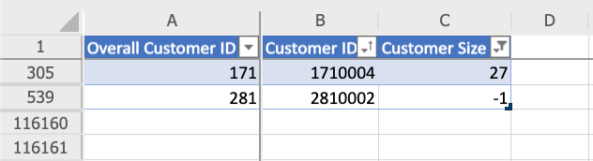
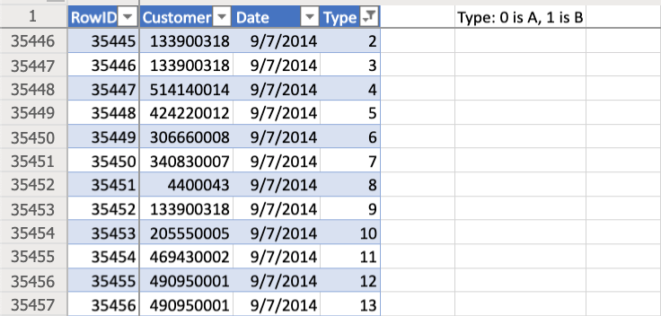
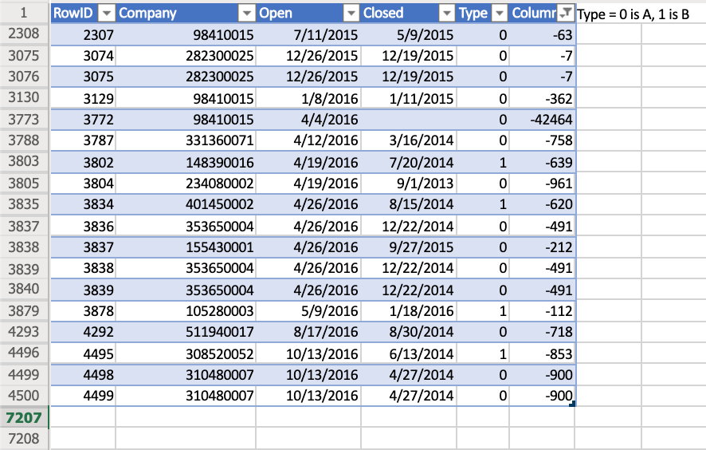
Data Cleaning
Editing incorrect data types
Eliminating outliers
Identifying NULL values
Notes:
Editing incorrect data types: On the sheet "Customer Info", the Customer Size column is only supposed to contain values of 0,1,2, and 3. Using the filter function, we found that there were additional values in the column which can be seen in the top left image. To fix these, we took the Customer ID associated with each incorrect Customer size and searched through the full data sheet to find what the Customer Size was for other observations. Then we updated the values to match.
Eliminating outliers: On the sheet "Table B", we wanted to check that the Requested amount was equal to the Late, On-Time, and Early columns added together. We did this by adding an additional column which summed columns on-time, early, and late together and then subtracted the requested column value. Using the filter function, we found that there was 5,622 observations that were negative, which could indicate that these orders had been unfulfilled. These 5,622 make up only 1.02% which is a very small amount of the whole data set. These observations were then eliminated.
On sheet "Table D", the column Type is only to have values that are either 0 or 1. Using the filter function, we found that there were other values in the column. Filtering out 0 and 1, there are 999 observations that do not contain a 0 or 1 in the type column. Of the 254,739 observations, these make up 0.04% so we eliminated those observations from the dataset since they make up a very small fraction of the data. An image of these values can be seen in the middle image.
On sheet "Table E", we wanted to check to make sure that the dates in the "open" column precede the "closed" column dates. To do this, we created a new column and subtracted the open column from the closed column. Filtering out the positive values from this new column, we found that there are 19 orders that had negative values meaning the open date was later than the closed date. These observations make up only 0.26% of the 7206 observations. These values were eliminated because they make up a small percentage of the data. This can be seen in the bottom image.
Also on this sheet, there are 394 observations with an empty value in the Closed date column. This indicates that an order is still open because it is not fulfilled at this time. To handle these, an If-Else statement will be used to make sure we avoid using them.

Slide 4

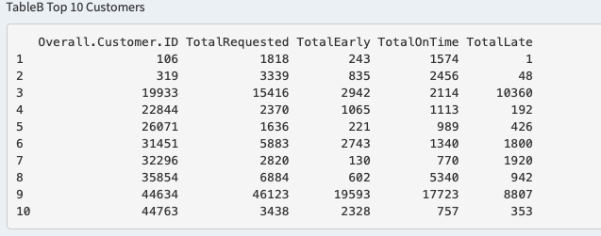
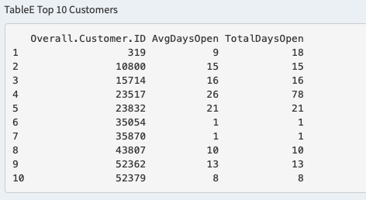
Top 10 Companies
Notes:
Here we can see a calculated list of top 10 companies from tables B and E for certain criteria.
The table on the left is the top 10 Customers for the most OnTime deliveries. So this shows us the top 10 companies which the falsified data shows we are consistently delivering on time to. These are sorted by CustomerID number, but we can also see that TotalEarly for all of these customers also seems to be fairly high (except for customer 19933).
The table on the right is the top 10 customers for the shortest average open to close time. To me this means these are the 10 companies which the falsified data tells us we are consistently closing out their orders within a maximum of 26 days. These are also sorted by customerID number, but we can see that customers 35054 and 35870 had an average of 1 days open. I believe this is because they only had one order which was only open for 1 day.
A little later we will show a pie chart of how some of these companies compare, and in the application we will be able to adjust these sort attributes of the top 10 customers so we can look at what customers are having the longest open to close time periods, and which companies are having the most late deliveries.

Slide 5
Analyzing Data with Visualization
Customer_Info
Overview on Data Type A, B and C
Yearly Frequency
Overall Monthly Frequency
Monthly Frequency by Each Year
Open Closed Table
Yearly View
Monthly View
Customer Size Bin Frequency
Early, Late, and On Time Delivery Trends
Delivery Table
Notes:
We used graphical functions of R to interpret the data visually. This helped us understand what kind of information, and the amount of information that the data included. We looked at each table separately first to understand what the data looked like.
First we looked at the Customer_Info table. This table included information about an overall customer connected to their more granular branches of each customer, and then the customer size of that customer.
Then we looked at the Data types A, B and C, which we looked at from a time perspective of Yearly Frequency, Monthly Frequency, and YearMonth Frequency.
We looked at TableE's Open and Closed data to understand a Yearly and Monthly view of what the data contained.
And finally we looked at table B's information about Deliveries, and we looked at those trends.

Slide 6
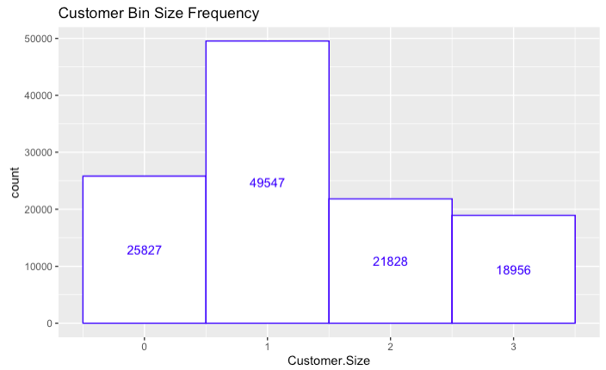
Customer Size 1 contains the largest number of customers.
Customer Size 3 contains the smallest number of customers.
Notes:
Customer bin size 1 contains the most amount of customers, Bin size 1 contains about double the amount of customers compared to other bin sizes.
This means we have more customers in our system which are bin size 1, or a medium to small size. Our second most frequent customer size is 0 or small.
We need to be aware of this when calculating information about the data as we may have more of 0 and 1 data than we do of 2 and 3.

Slide 7
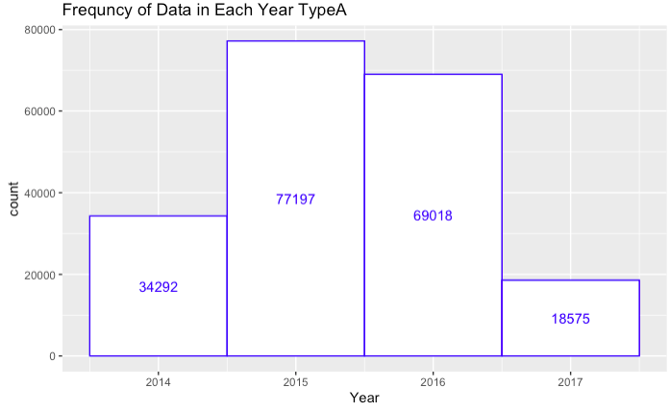
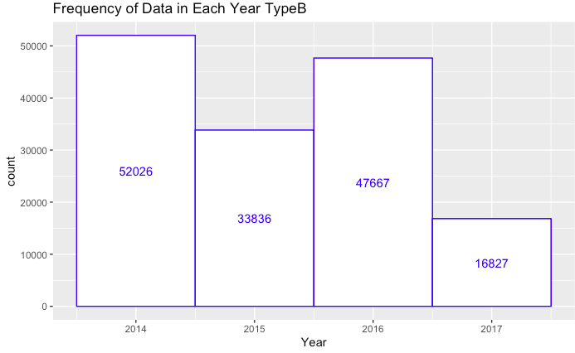
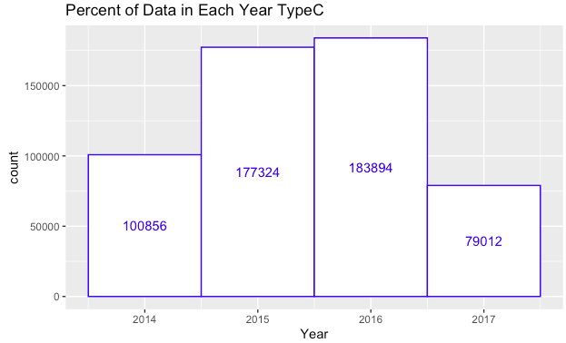
Frequency of Yearly Data by Each Type
Type A and C data contains most data in 2015 and 2016. Type B data contains most data in 2014 and 2016.
Question: Type B does not have similar trend with Type A and Type C. What can be the reason for this? We also know that we only contain half year of data in 2014, however Type B contains most data in 2014.
Notes:
Type A and C data contain most of their data in 2015 and 2016, with only about half of that in 2014 and 2017. This could be because data was recorded over time and started recording in the middle of 2014 and ended recording in 2017.
Type B data does not have a similar frequency, instead 2015 and 2017 are about half as frequent as 2014 and 2016. I can conclude this may be because of some way the data is recorded, maybe only half of the year in 2015 and 2017 were recorded, could be a data which has a half a year break every other year. Etc.

Slide 8
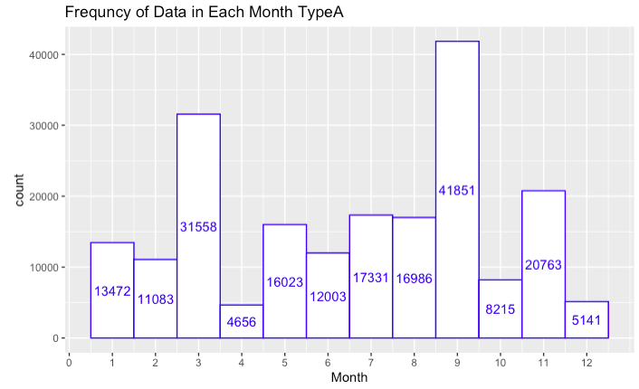
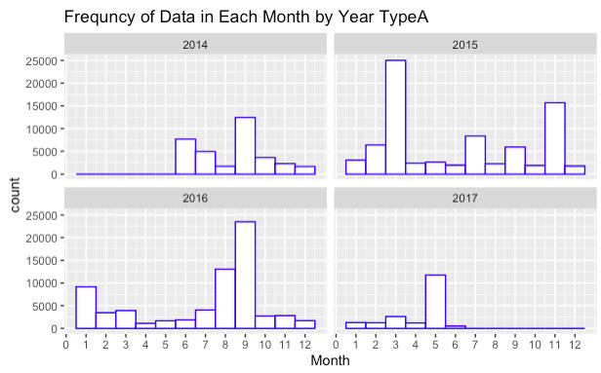
Type A Data Monthly frequency
Type A Data Monthly Frequency by Each Year
Bar plot on the left show frequency of Overall Monthly Type A data. Month 9 contains the most Type A data followed by month 3 and month 11.
The bar plots on the right show frequency of monthly type A data by each year.
Notes:
On the left we have a graph of the Type A data month frequency by month. This shows the Type A data is most frequent in month 9 and month 3. If this corresponds to delivery dates or sales dates, this may indicate an increase in business during this time.
Looking at the time series data on the right, this tells a similar tale. We see that data starts in month 6 of 2014, and spikes in Month 3 and month 9, and data ends in month 7 of 2017.

Slide 9
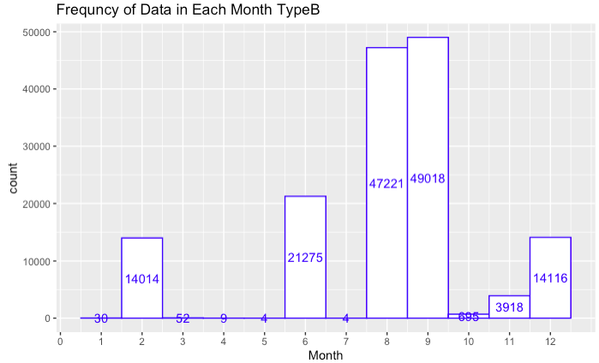
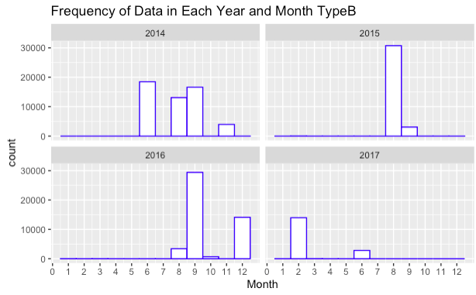
Type B Data Monthly Frequency
Type B Data Monthly Frequency by Each Year
Bar plot on the left show frequency of overall monthly type B data. Month 9 has the most Type B data followed by month 8 and month 6. Some interesting founding on Type B is that there are very small amount of Type B data in month 1,3,4,5,7,and 10
The Second bar plot shows monthly type B data by each year.
Notes:
The Type B data Frequency grouped by Month is shown on the left. Here we can see this data is extremely seasonal, only having significant values in a few months, especially months 8 and 9.
The graph on the right shows the continuous frequency of Type B data throughout the years by month. We see this shows similar data to the graph on the left, indicating some type of seasonality to the data in months 8 and 9 of 2014, 2015 and 2016. It appears looking on the right that data starts in month 6 of 2014 and ends in month 7 of 2017, but that there is not continuous activity for this data.

Slide 10
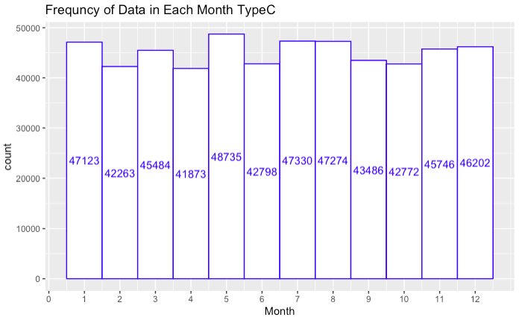
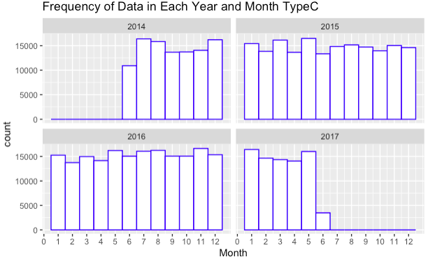
Type C Data Monthly Frequency
Type C Data Monthly Frequency by Each Year
The Bar plot on the left show frequency of overall monthly Type C data. Type C data is evenly distributed throughout the months.
The bar plots on the right shows monthly type C data by each year. The data is evenly distributed monthly in each year.
Notes:
On the left we see a graph of the Type C data frequency grouped by month. This data is distributed fairly evenly throughout the years and months, every other month is a little higher than the last month.
On the right we see a graph of the Type C data frequency grouped by month for each year. This data is still distributed evenly, only differing slightly. It appears this data begins in the middle of 2014 and ends in the middle of 2017.
This is nice to know that the data is distributed well throughout this series of time.

Slide 11
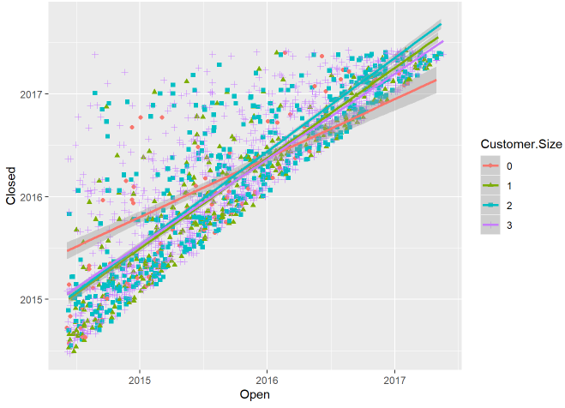
Open and Closed Data Table
Scatter plots for open vs closed dates for each customer size
Best fit lines for each customer size
Notes:
The plot above shows that most of the data are concentrated along the line where Open and Closed date is not too far apart from each other. However, we have few data where closed date is far apart from the open date.
By looking at the graph it appear to be those that were taking longest to close are located in customer bin size 3.
The best fit lines for each Customer.size on its open and closed data is displayed. Customer.Size 0 stands out from the rest. It indicates that around mid 2014 to late 2015 data that belongs to Customer.Size 0 were taking longer to close on average compared to any other Customer.Size and from late 2015 to mid 2017 Customer.Size 0 were closed early on average compared to Others.

Slide 12
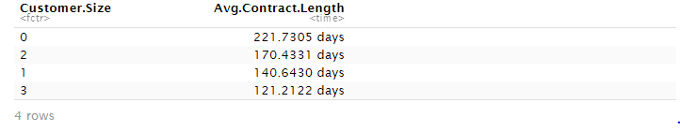
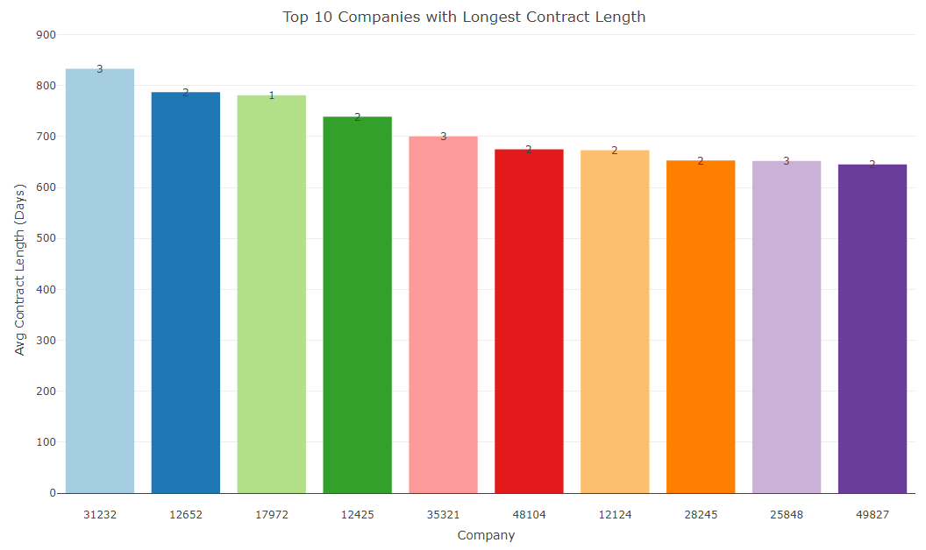
The Overall Average Contract Length is 163.50 days
Number on top of each bar indicates its customer size
The longest contract length is at 833 days for Company 31232
Notes:
The contract length table was joined with customer info table to enable grouping by its Overall customer id and Customer Size.
The table provides average contract length of each customer size and it is displayed in descending order. On average customer size 1 has the longest contract length.
The Bar chart displays top 10 companies with longest contract length and the number on top of each bar indicates which customer size the company is belong to.
Interestingly, the company with the longest contract length is in customer size 3, which has the shortest contract length on average.
Also none of the companies in top 10 contract length belongs to customer size 0 despite of customer size 0 having the longest contract length on average.
Base on this observation, one might make an inference that customer size 0 will likely have the least variance on contract length. Since it has the largest avg contract length but doesn't contain extremely large contract length like other customer size does.

Slide 13
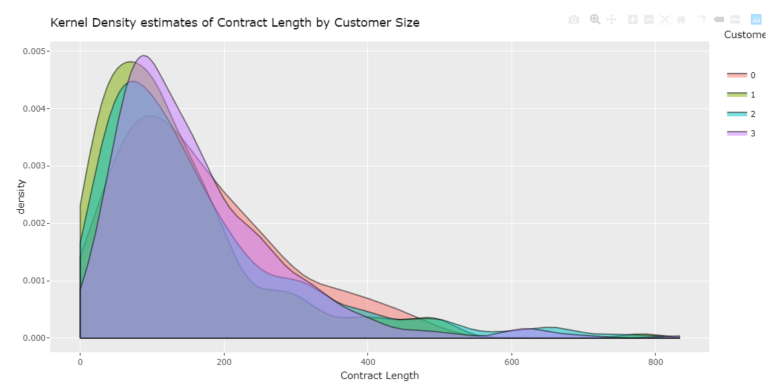
Customer Size | n | mean | sd | median | mad | min | max
Overall | 933 | 156.81 | 127.8 | 122.75 | 90.07 | 0 | 833
0 | 44 | 163.52 | 111.08 | 139 | 104.89 | 8 | 459
1 | 189 | 134.34 | 119.77 | 102 | 84.51 | 0 | 781
2 | 326 | 162.94 | 142.37 | 120 | 96.37 | 1 | 787
3 | 374 | 162.03 | 119.07 | 132.07 | 86.26 | 0 | 833
The density graph on contract length by each customer size share similar distribution, skewed to the right.
Most(around 95%) contract lengh stays below 400 days.
Notes:
Continuing from previous observation, the kernel density graph further ensure that the customer size 0 has the least variance since its tail is shorter than any other customer sizes.
Looking at the table we can check that customer size 0 does indeed have the least variance since its standard deviation has the smallest number compared to others.
All of the graphs has similar distribution, skewed to the right. Meaning there are very small amount of companies with contract length over 600 days.
Around 95% of the contract length stays under 400 days.
The term mad is same as mode which is the most occurring number in a set of observations. So the pick on the graphs will correspond to the number in mad that is on table. For example Customer size 0 has it's pick on 104.89 days.
Meaning 104.89 days is the most frequent contract length in customer size 0.
(mad = mode is the most occurring number in a set of observations. Mode of a Data Set is calculated by finding the frequency of each element within the set)
(kernel density estimation (KDE) is a non-parametric way to estimate the probability density function of a random variable. )
the technique allows one to create a smooth curve given a set of random data. The estimation attempts to infer characteristics of a population, based on a finite data set

Slide 14
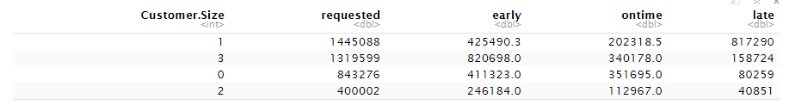
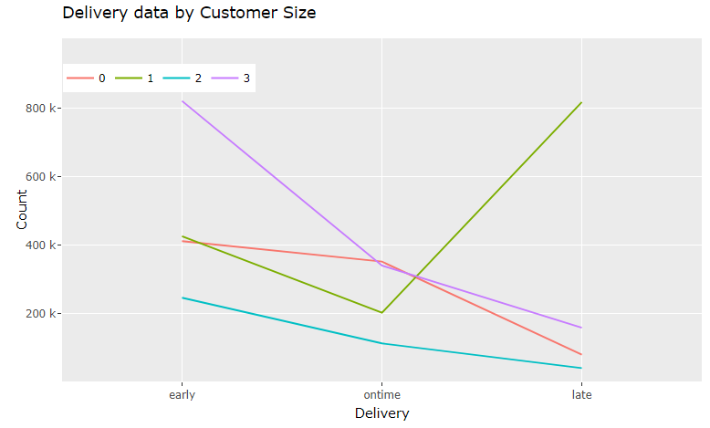
Table shows sum of requested, early, on time, and late items for each customer size.
Graphs for each customer size's early, on time and late items.
Customer size 1 has upward trend indicating most of requested item was finished late.
Notes:
The table above shows the delivery counts sorted by early, on time, and late variables grouped by its customer size and the graph provides visualization of the table.
One thing we can note from the previous customer bin size frequency histogram ,we found that the customer size 3 contains the least amount of customers and the customer size 1 contains the most amount of customers (about 2.5 times more compared to customer size 3), however, from the given table above we can see customer size 3 contains large amount of delivery request. This might indicate that customer size 3 contains larger clients.(meaning companie with larger order size)
From the given delivery count graph we can clearly see that the customer bin size 1 stands out from the rest.
It appears that the customers that belong to customer size 1 experienced the most delay on their delivery. In fact, majority of their delivery was late.
This is something the company should be alerted and find out why the customer bin size 1 is experiencing late delivery.

Slide 15
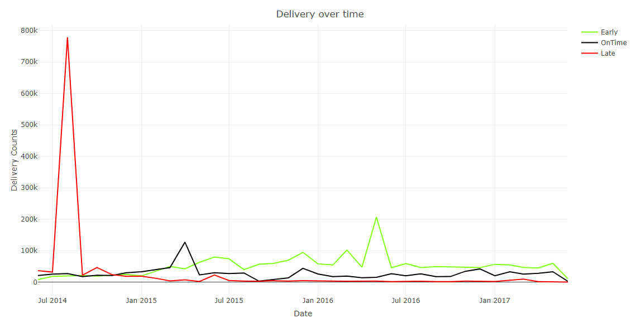
Overall trend over time for all customer sizes combined
Late delivery disproportionally large on August 2014
Overall number of late delivery is less than the number of on time and early delivery throughout the years.
Notes:
Now we will look in to the delivery data over time. The graph explains the trends over time on delivery data. The lime green indicates number of early delivery, the black indicates number of on time delivery and the red indicates the number of late delivery.
It looks like the SEL had most of their late delivery concentrated around August 2014. This is something the company can investigate what had happened during that time frame.
Overall, the number of late delivery stays below the lines of number of on time and early delivery through out the years, which indictes that SEL is making consistently higher number of early and on time delivery compared to the number of late delivery.

Slide 16
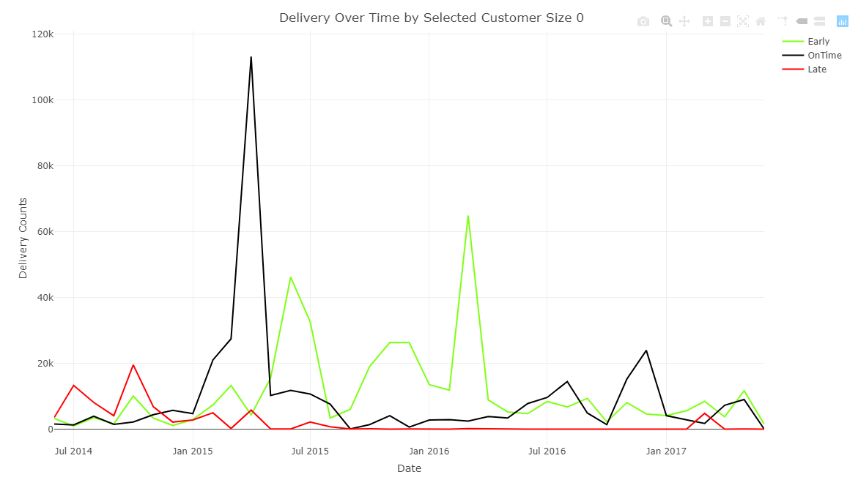
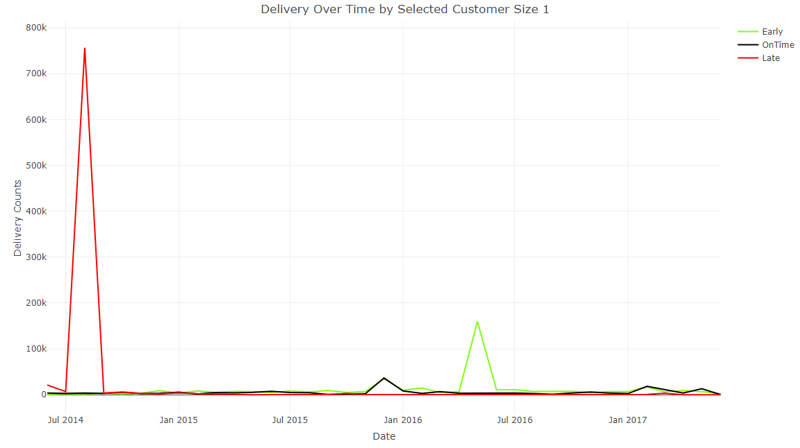
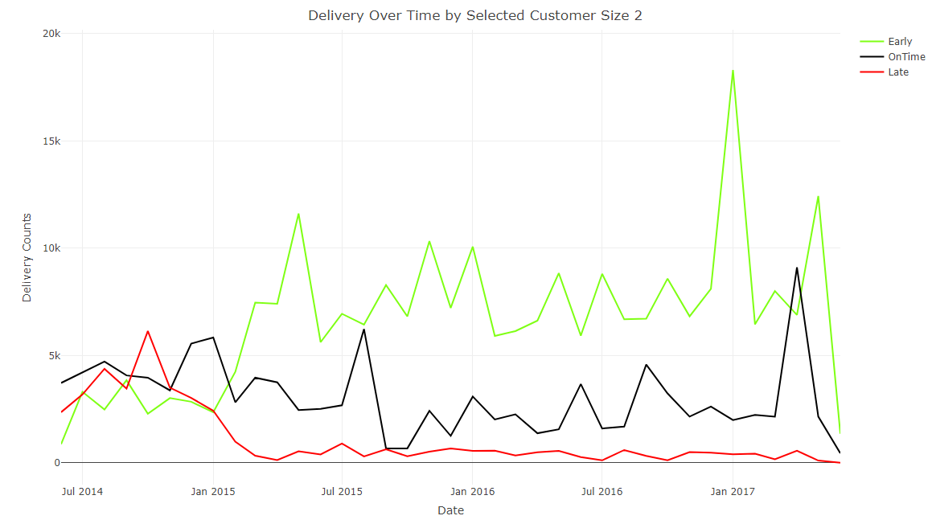
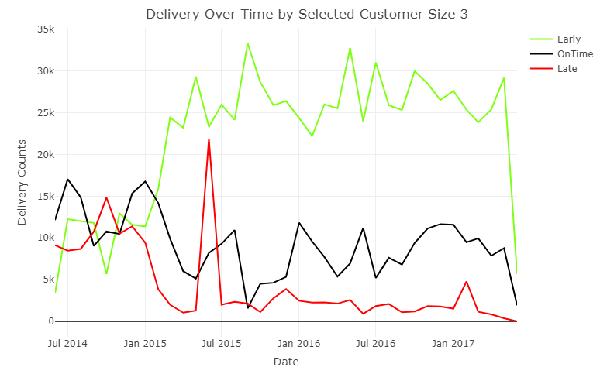



Notes:
Now we will further look into the delivery over time data by each customer size. Right off the hook we can see the graph on the top right which visualizes delivery over time by customer size 1, resembles the previous delivery over time graph for overall. The late delivery on overall graph was influenced from delivery over time graph for customer size 1.
This also explains the majority number of late delivery on customer size 1 we observed previously was occurred on august of 2014. Further assessment from SEL is needed to figure out the reasoning behind this, however, we can now see that the SEL isn't consistently making a late delivery on customers that belong to customer size1, it appears to be an one time event.
The blue circles on the graphs indicates where SEL made more late delivery than on time and early delivery to their customers, it was between mid 2014 through late 2014. The company might had some setbacks on their deliveries during that time, however, SEL seem to keep their late delivery amount under control for the most part.

Slide 17
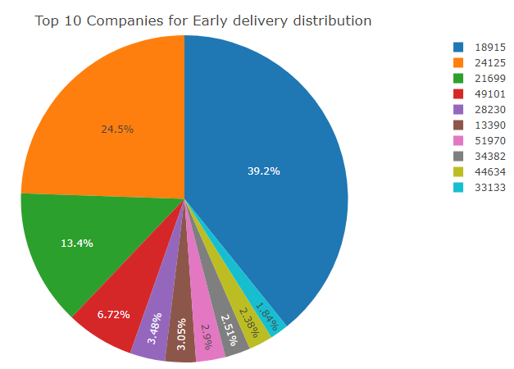
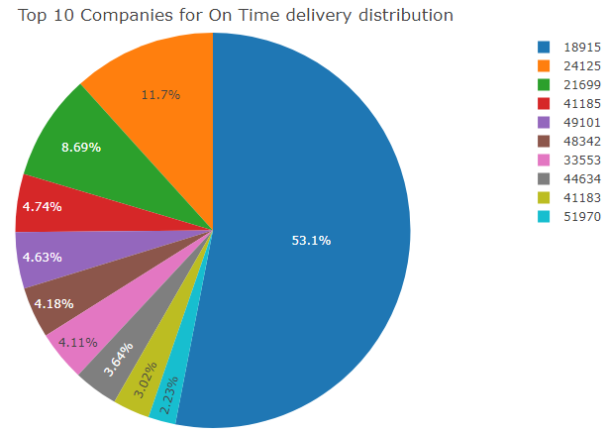
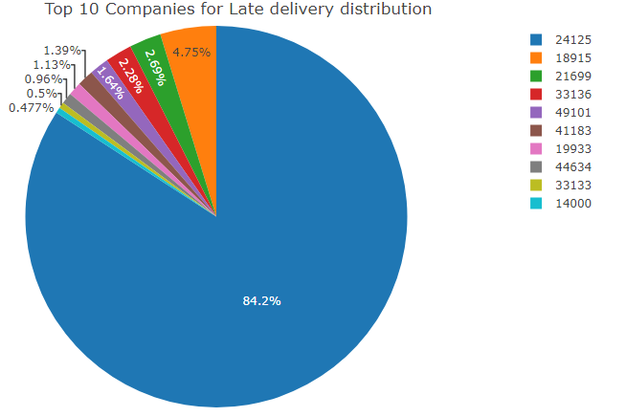
Notes:
Lastly, we will look at the pie charts that show the top 10 companies for each category of delivery distribution. (early, on time, late)
Looking at the graph on the far right shows Late delivery distribution. Company number 24125 makes up 84.2% of the late delivery data,
But only makes up 24.5% of early distribution and 11.7% of on time distribution. The major amount of late delivery on customer size1 might have been contributed from the company number 24125.
This information can be used to follow up with each indivisual company to improve the customer relation and take measures to minimize amount of late deliveries for those companies with high distribution of late deliveries.

Slide 18
Determining the Featureset for ML and other Models

Slide 19
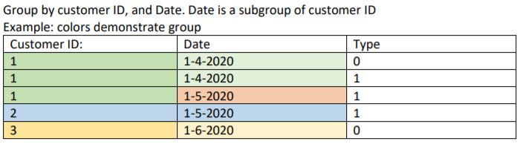
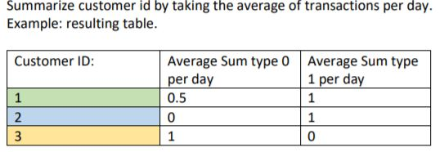
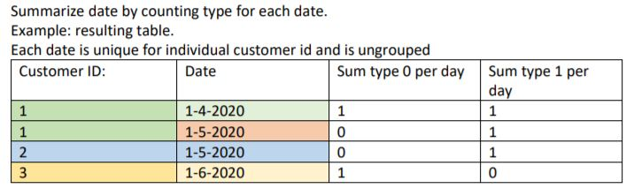
Determining Feature Set for Machine Learning
Example of Process for determining features of table A
There is now a unique customer ID for each tuple
Similar processes were done for each table in the database
After features are created for each table, they were joined with the Customer Info table to summarize them further by Overall Customer ID.
Notes:
Using a group by statement on table A of the database for both customer ID and date,
You can se that each individual customer ID and unique date is now in a group.
Then a summarize function is called to make every date unique to customer ID.
In this example, for the date 1-4 one type 0 and one type 1 were counted for this date.
Then summarizing for customer ID. The average of each type was used.
In the example there are 0 type 0 transactions on 1-5 and 1 transaction for type 0 on 1-4 for customer ID 1
Therefore the average transactions per day for type 0, and customer 1 would be 0.5.
Similar strategies were utilized to implement similar features for every table in the database.
FULL OUTTER JOINS were used between tables to retain all information from both tables.
After features were summarized for each individual table, they were connected with the Customer Info table.
features were summarized further to indicate information unique to each Overall customer ID instead of just customer ID.

Slide 20

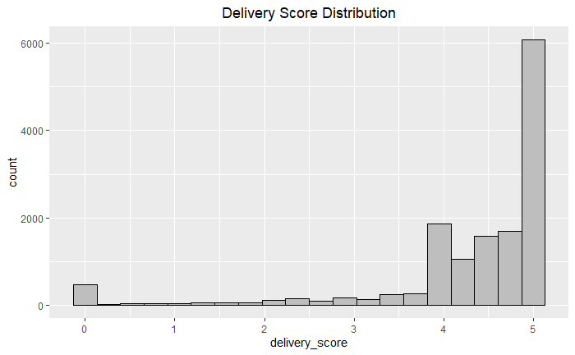
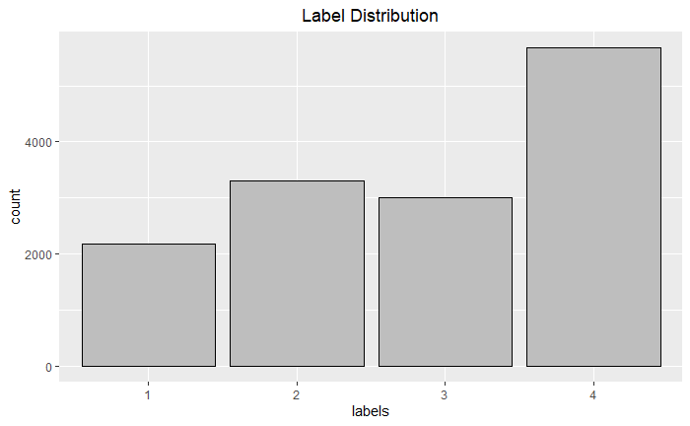
Determining Classification Labels
Notes:
A delivery score was created to demonstrate the differences between overall customer ids, based on the total early, total on time, and total request features of table B
The calculations created are a number between 0 and 5,
With 0 indicating that all transactions are late, and 5 indicating that all transactions are early.
The scores are then separated into 4 different factors for classification analysis based on the size of the delivery score.
Both of these features were then added to the complete features list.

Slide 21
Preliminary Statistical, and ML Algorithms

Slide 22
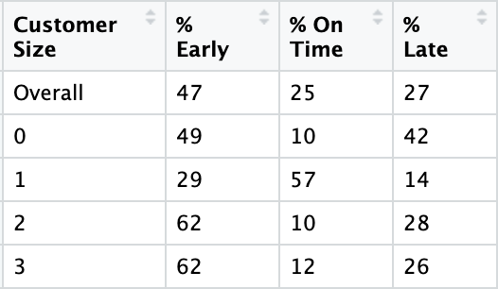
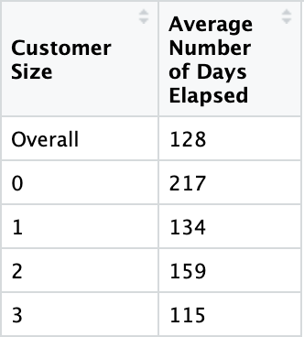
Basic Math Method
Merged Customer Info and Table B to get percentages of parts delivered
Analyze for patterns
Predicting future values
Reliability?
Merged Customer Info and Table E to get average number of days from open to close for each customer size
Notes:
We were asked to use three different types of analysis on the data, and one of those was basic math, or simple statistics. We utilized this for obtaining values from the Table B and Table E in the dataset. First we merged Customer Info table and Table B together to calculate the overall percentage of how many units were early, on time, and late. This same method was also used to get percentages for each customer size. As seen in the top table, customer sizes 2 and 3 which are the larger two company sizes, generally had the same values for early, late, and on time with the highest percentage being in the early column. Customer size 1 had over half of their parts delivered on time and customer size 0 had most of their parts almost evenly split between being delivered early or late. This is helpful in assessing customer satisfaction by helping identify customers who are getting a higher percentage of late deliveries than the others.
The bottom table gives the average number of days that elapsed for customer orders and are given for each customer size as well as the overall average for the dataset. This was created by merging Table E and Customer Info together and summarizing the columns. It is interesting to see that generally all customer sizes have order lengths similar to the overall average except customer size 0. Their average is nearly twice as long for them. Connecting this to the top table, this makes sense since customer size 0 has the highest percentage of late delivered parts being the smallest customer size. This is something that could be investigated further.
Both of these tables are beneficial because they can help to give some predictions of when orders might be fulfilled for a customer by multiplying the total number of parts by each of the percentages to get an estimate of how many might deliver early, late, and on time.
When thinking about reliability, this can be used as a rough estimate by SEL to give approximations of when parts may be delivered or when the order may be fully complete. But there are factors that could be affecting the delivery times and length of orders that we were not able to assess in the dataset which must be considered when trying to understand these results.

Slide 23
Linear Regression
Model summary
Residual standard error: 0.8889 on 20075 degrees of freedom
Multiple R-squared: 0.001856, Adjusted R-squared: 0.001657
F-statistic: 9.331 on 4 and 20075 DF, p-value: 1.57e-07
After predicting the testing data, and converting the predictions into classification data
Results:
Using an 80-20 training testing split linear regression was preform on the dataset.
As you can see by the standard error and R-squared linear regression not a good model for this feature set.
The noise in the data is creating a straight-line predicting customer size 2 for virtually all actual customer sizes.
 | 0 | 1 | 2 | 3
0 | 1 | 0 | 191 | 0
1 | 1 | 0 | 2124 | 1
2 | 0 | 0 | 1390 | 1
3 | 0 | 1 | 1309 | 1
Notes:
Customer size was converted to numerical data, and Linear regression was preformed on selected features in the feature set
as you can see the model returned a high standard error, alongside really low R-squared values,
this indicates linear regression is a poor model for our data.
basically linear regression fits a straight line(hyperplane in this dimension) perpendicular to the classification axis
for this feature set,
the algorithm basically predicts customer size 2 for virtually every customer size regardless of the actual size of the customer.
Ultimately the binning of customer size was a problem for Linear regression,
Results would be more accurate if customer size was originally numerical data with more granularity.

Slide 24
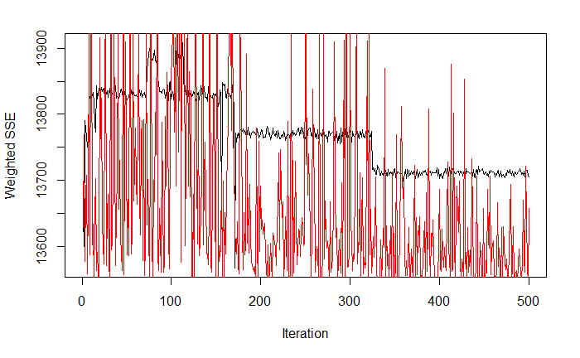
Multilayer Perceptron
Iterative Error:
Prediction for Testing Data:
Using the same 80-20 training, and testing dataset multilayer perceptron was performed on the dataset.
From the iterative error plot it looks like multilayer perceptron is also not a good model.
As you can see this model also just predicts 1 for every customer size
 | 0 | 1 | 2 | 3
0 | 0 | 192 | 0 | 0
1 | 0 | 2126 | 0 | 0
2 | 0 | 1391 | 0 | 0
3 | 0 | 1311 | 0 | 0
Notes:
Multilayer perceptron was preformed on the same training and testing dataset as linear regression,
from the iterative error plot it looks like the perceptron model is also not a good fit for this dataset.
however this model predicts customer size 1 for every customer.
this is simply what customer size bin has the highest number of customers in it.
Perceptron is one of the oldest machine learning algorithms, and due to the dataset not being linearly separable the data will never converge.

Slide 25
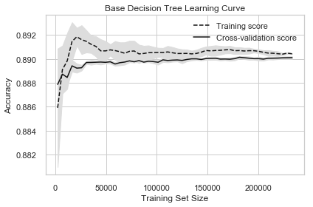
Late Delivery Classification
Notes:
We also made a classifier to identify late deliveries. this is the learning curve of our very first model. As the model trained on more data, the accuracy score improved. Though 89% accuracy is usually good, this was a big problem.

Slide 26
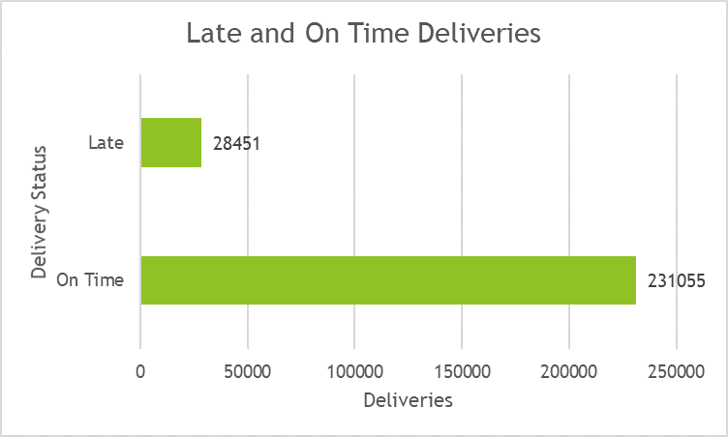
Background
Motivations
Identify transactions at risk for late parts deliveries
Emphasize value in more data
Issues
Highly imbalanced classes
Very few variables to use
Solutions
Oversampling
Lag variables
Notes:
Our main motivation was to help the company identify late parts delivery. This might help identify something along the supply chain and this would allow us to emphasize the value in data.
Though the previous plot looked really good, there was a problem with the data. It is highly imbalanced. 89% of the 288 thousand unique transactions were On Time. Big imbalances in classes can result in poor generalization of the minority class which can't be seen through some metrics. From a business standpoint, identifying late deliveries might be more important than identifying on time deliveries, too.
Unfortunately, we had few variables to use as well. So, our solution to both of these problems were to use synthetic oversampling and create lag variables based on the variables we already have.

Slide 27
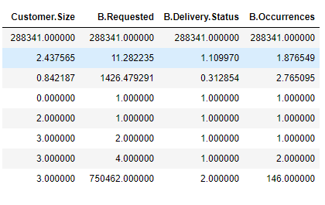
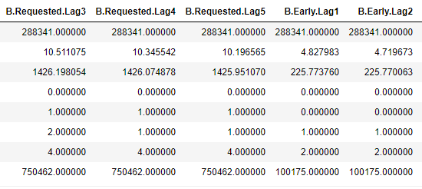
Feature Selection
Customer Info and Table B
Output: Delivery Status (new variable)
If Late > 0, transaction was late. Else on time
Input features
Customer Size
Requested parts
Additional lag variables
Last 5 requested, early, late, and on time values
Notes:
Feature selection was through customer info and table b. The output was Delivery Status which was on time or late. We made this from the Early, On Time, and Late features from table b. If Late was greater than 0, we logged this in the Delivery Status variable as a late delivery. Afterwards, we dropped Early, Late, and On Time because it's a glimpse of whats late or on time.
We used decision tree, logistic regression, and random forests classifiers on the base data, oversampled data, and oversampled data with lags. 5 lags each were created from the 5 past requested, early, on time, and late values to make 20 lag features.

Slide 28
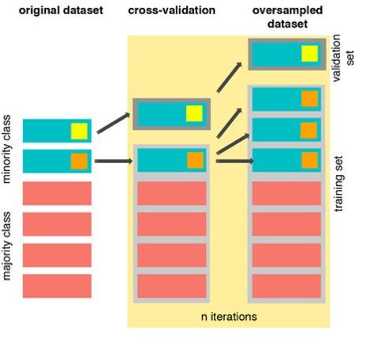
Data Sampling
Original dataset
90% train, 10% test set split by random sampling
Preserved original data distributions
5-fold Cross-validated model training
Split into late and on time classes
Better accuracy on random variations of data
Synthetic oversampling (SMOTE)
CV train set oversampled -> more balanced classes
Since synthetic data, helps combat overfitting
Better accuracy on the imbalanced class (maybe)
Notes:
Data was split to a 90% training set and 10% test set. This preserved the original data distributions.
5 fold cross validation was used during model training. The process divides the training set to folds and iterates through the folds training multiple models based on some settings. The average performance of these folds were used to identify the settings for the best model.
The models using synthetic oversampling took the cross-validation training set to make new fake data for balanced training. You can see this in the left visualization how three arrows come out of the middle aqua box and magically makes 3 new aqua boxes. This can help increase performance on imbalanced classes.

Slide 29
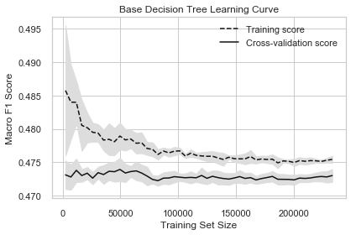
RESULTS
Notes:
This is the real learning curve for the base decision tree model. The one earlier was based on accuracy. We used the macro averaged F1 metric to choose our best models. This metric takes the average F1 score from both classes so having one class performing well isn't good enough to have a great macro average.

Slide 30
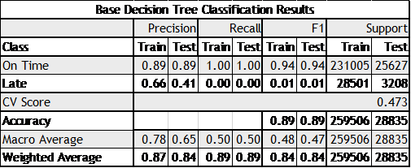
Base Models
Performance (all models)
CV Macro avg ~0.47 CV
Great predicting On Time
Bad predicting Late deliveries
Notes:
Our base models actually did VERY poorly when it came to the F1 macro. This table shows why. While recall isthe ability to find all relevant instances of the class in a dataset, precision is the proportion of the data points our model says was relevant that are really relevant.
The table to the right shows that the model was getting all of the on time predictions right and all of the late predictions wrong.

Slide 31
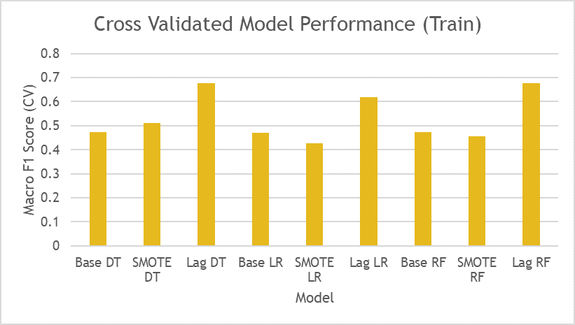
All Models
Oversampling had mixed results
Increaset decision tree by 5%
Decreased the other two
Best models had lag features
20% CV score from base models for both random forest and decision tree
Notes:
After running all of our models, this was the result by CV score. We can see that massive improvements were made with more input variables. Though oversampling had mixed results with a 5% increase for the decision tree over the base model being the best, lag variables with synthetic oversampling improved all models. logistic regression jumped by 14% while decision tree and random forests jumped by 20%.

Slide 32
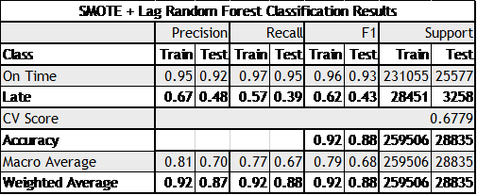
Outcomes
Best classifier
68% CV score
On Time: near perfect
Late: 42% increase
Improvements with more useful data
Location
Specific parts
Detes (e.g. original)
Notes:
This final classification result table shows how well the random forest model performed. It had near perfect on time performance while increasing performance on late models by about 40% by F1 score.
Though the overall performance still isnt great for insights in a production environment, it does show promise. Improvements can be made by considering other useful data such as customer location, specific parts in a transaction, dates, and others.

Slide 33
Thank You

